Slide 1
Creating Charts
Microsoft Excel 2013
Lesson 12

Slide 2
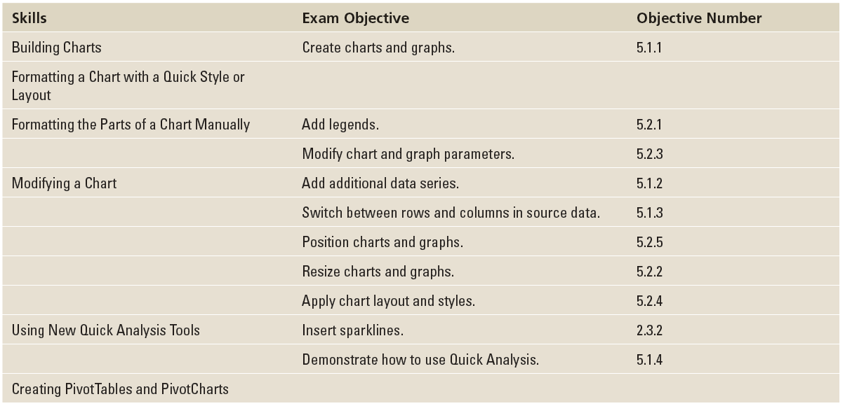
Objectives

Slide 3
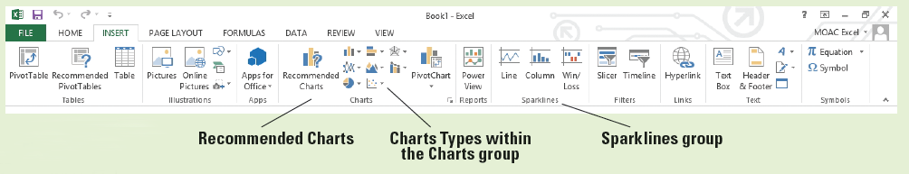
Software Orientation
The INSERT tab contains the command groups you’ll use to create charts in Excel (below).
To create a basic chart in Excel that you can modify and format later, start by entering the data for the chart on a worksheet. Then select that data and choose a chart type to graphically display the data.
By choosing a chart type, a chart layout, and a chart style—all of which are within easy reach on the ribbon’s INSERT and CHART TOOLS tabs—you will have instant professional results every time you create a chart.

Slide 4
Step by Step: Select Data to Include in a Chart
GET READY. LAUNCH Excel.
OPEN the 12 4thCoffee Financial History file for this lesson.
Select B2:B8 (the 2010 data).
Click the INSERT tab, and in the Charts group, click the Pie button. Click the first 2-D Pie chart. A color-coded pie chart with sections identified by number is displayed.

Slide 5
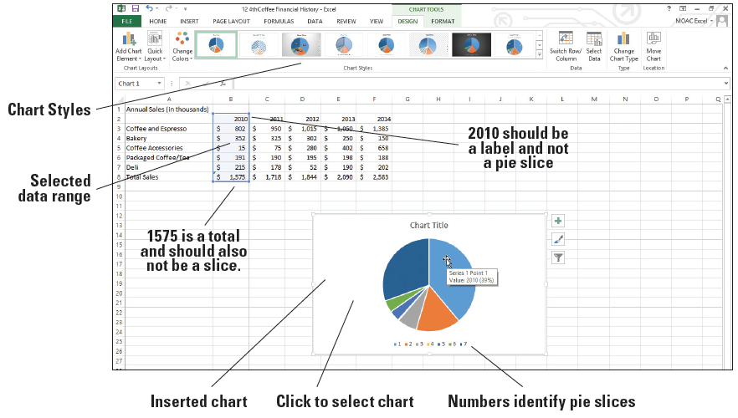
Step by Step: Select Data to Include in a Chart
Move the mouse pointer to the largest slice. The ScreenTip shows Series 1 Point 1 Value: 2010 (39%), as shown at right. This corresponds to the label 2010 rather than actual data.
Move to the second largest slice and you’ll see that the value is 1575, which is the amount for the total. Neither the column label (2010) nor the total sales amount should be included as pie slices.

Slide 6
Step by Step: Select Data to Include in a Chart
Click in the chart’s white space and press Delete. The chart is now deleted and the CHART TOOLS tab disappears.
Select B3:B7, click the INSERT tab, in the Charts group, click Pie, and then click the first 2-D Pie chart. The correct data is displayed, but the chart is difficult to interpret with only numbers to identify the parts of the pie.
Click in the chart’s white space and press Delete.
Notes:
Troubleshooting: To delete a chart, click in the white space then press the Delete key on your keyboard. If you click on the graphic or another chart element and press Delete, only the selected element will be deleted.
Troubleshooting: When you insert a chart into your worksheet, the CHART TOOLS tabs (DESIGN and FORMAT) become available in Excel’s Ribbon with the DESIGN tab active by default. You must select the INSERT tab on the ribbon each time you want to insert a chart.

Slide 7
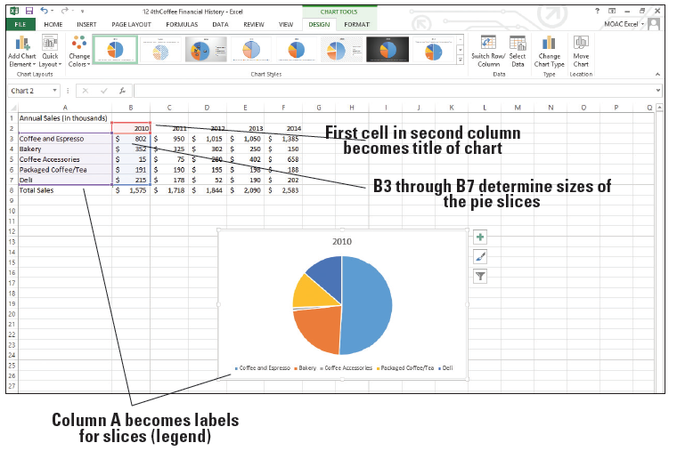
Step by Step: Select Data to Include in a Chart
Select A2:B7, click the INSERT tab, and click Pie in the Charts group. Click the first 2-D Pie chart. As illustrated at right, the data is clearly identified with a title and a label for each colored slice of the pie.
Move the mouse pointer to a blank spot within the chart and drag the chart to move it below the data.
Notes:
Troubleshooting: Just like deleting an element, if you drag a chart element, the mouse will move the element within the chart.

Slide 8
Step by Step: Select Data to Include in a Chart
Click outside of the chart, click FILE, and then click Print. Notice that the Annual Sales data appears with the chart on the page.
Press Esc and click on the Chart and choose FILE, Print. Now notice that the chart appears by itself.
CREATE a Lesson 12 folder and SAVE the workbook as 12 Charts Solution.
PAUSE. LEAVE the workbook open for the next exercise.
Notes:
Take Note: If you want to print just an embedded chart on a workbook, select the chart before you choose FILE, Print.

Slide 9
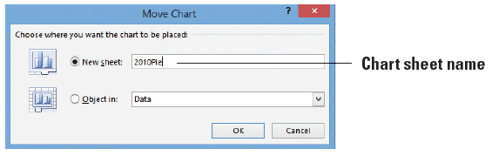
Step by Step: Move a Chart
GET READY. USE the workbook from the previous exercise.
Click in the white space on the chart to select it.
On the DESIGN tab, click the Move Chart button.
In the Move Chart dialog box, click in the New sheet box and type 2010Pie to create the name of your new chart sheet (below).

Slide 10
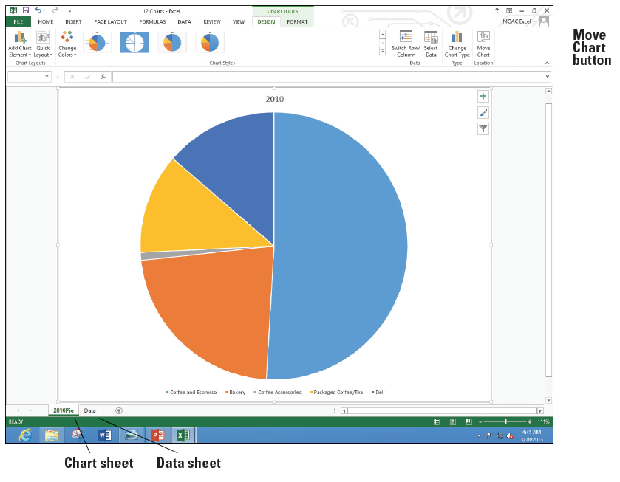
Step by Step: Move a Chart
Click OK. The chart becomes a separate sheet in the work- book (right).
Click on the Data worksheet tab to return to the data portion of the workbook.
SAVE the workbook.
PAUSE. LEAVE the workbook open for the next exercise.

Slide 11
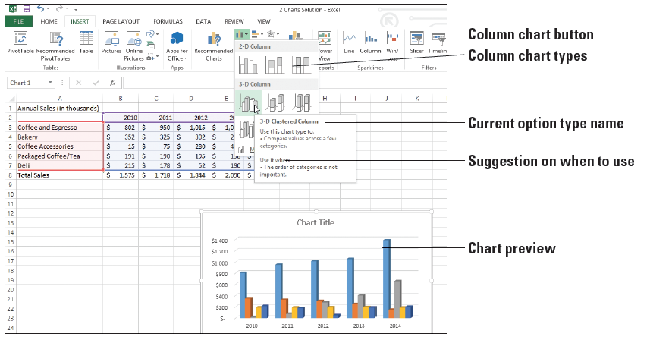
Step by Step: Choose the Right Chart for Your Data
GET READY. USE the workbook from the previous exercise.
Select cells A2:F7.
Click the INSERT tab, and in the Charts group, click Column. In the Column drop-down list, move to each of the options. When you pause on an option, Excel shows a preview of the chart on the worksheet and a description and tips for the selected chart type. Under 3-D Column, move to the first option. The ScreenTip shows that the type of chart is a 3-D Clustered Column (above).
Notes:
Troubleshooting: Make sure you do not include row 8, the Total Sales row. Otherwise, the last column in each year will be huge and dwarf the other columns. It is standard practice not to include totals in column and bar charts. In some instances it may be helpful to add a line with the totals as a separate axis on the right.

Slide 12
Step by Step: Choose the Right Chart for Your Data
In the drop-down list, click 3-D Clustered Column. The column chart illustrates the sales for each of the revenue categories for the five-year period. The CHART TOOLS tab appears with the DESIGN tab active.
Anywhere in a blank area on the chart, click and drag the chart below the worksheet data and position it at the far left.
Click outside the column chart to deselect it. Notice that the CHART TOOLS tab disappears.

Slide 13
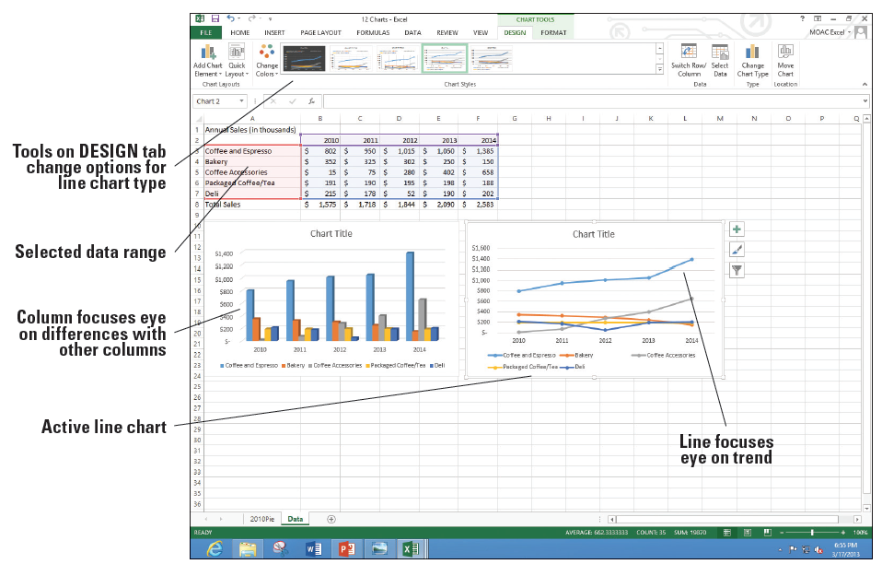
Step by Step: Choose the Right Chart for Your Data
Select A2:F7, click the INSERT tab, and in the Charts group, click Line. In the 2-D Line group, click the Line with Markers option (first chart in the second row). Position the line chart next to the column chart. Note that the CHART TOOLS tab is on the ribbon with the DESIGN tab active (above).
Notes:
Take Note: Take a minute to study the two charts. In the column chart, Coffee and Espresso are by far the largest revenue sources, but Coffee Accessories are catching up. On the line chart, notice that Coffee and Espresso increase over time, but that Coffee Accessories increases faster. Bakery items are decreasing, and the Deli sales is a bit up and down.

Slide 14
Step by Step: Choose the Right Chart for Your Data
Click the column chart and click the DESIGN tab.
Click the Move Chart button and in the New sheet box, type Column, and then click OK.
Click the Data worksheet tab, select the line chart, click the Move Chart button, and in the New sheet box, type Line, and then click OK.
SAVE the workbook.
PAUSE. LEAVE the workbook open for the next exercise.
Notes:
Another Way: You can also right-click on a chart and select Move Chart.

Slide 15
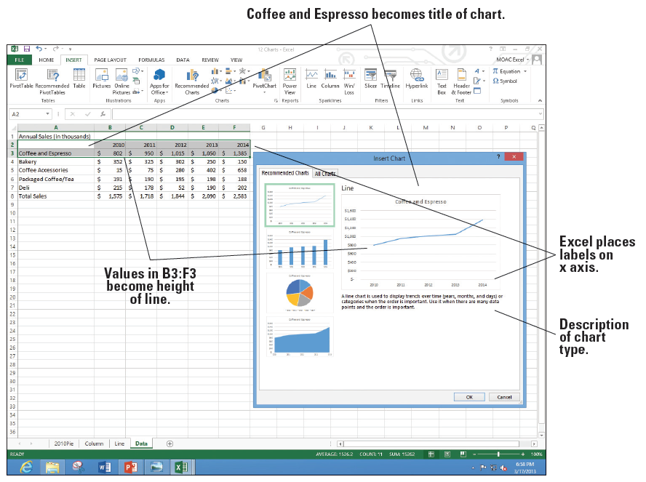
Step by Step: Use Recommended Charts
GET READY. USE the workbook from the previous exercise.
Click the Data worksheet tab.
Select the Year labels and Coffee and Espresso cells A2:F3, click the INSERT tab, and then click the Recommended Charts button. Notice that Excel recommends four chart types (right). Excel explains when you use each of the charts underneath the example.

Slide 16
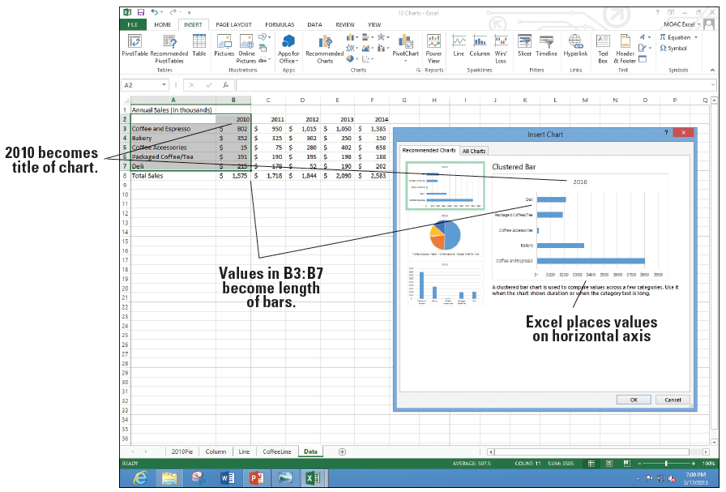
Step by Step: Use Recommended Charts
Click the other three chart types and read each description. Click the Line chart, and then click OK.
Click the Move Chart button, and in the New sheet box, type CoffeeLine, and then click OK.
Click the Data work- sheet tab, select cells A2:B7 to include the labels and data for 2010, and then on the INSERT tab, click the Recommended Charts button. Notice the three chart types recommended this time (above).
Notes:
Take Note: Notice that three charts are recommended this time compared to the four different charts in Figure 12-9. Because 2010-2014 is in the first row in the previous example, charts that show trends are included (line and column). Because the first column is selected this time, charts that compare items are selected (bar, pie, and column charts). There is some overlap in the recommended chart types; column charts are suggested in both cases.

Slide 17
Step by Step: Use Recommended Charts
Click Cancel. Select A2:F7 and click the Recommended Charts button. Look at each of the suggested choices and scan the description. Click Cancel.
Select A8:F8 and click the Recommended Charts button. Notice that the choices are even different from the options at right. Click Cancel.

Slide 18
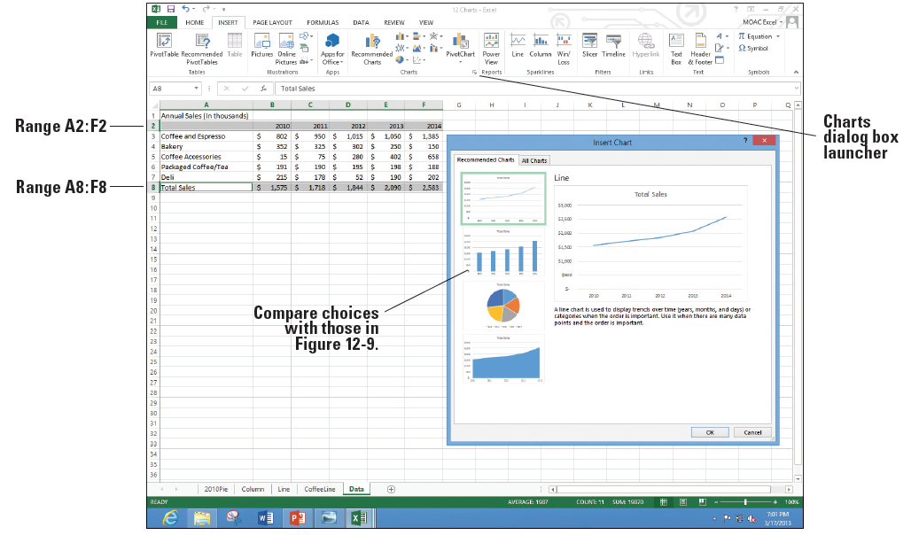
Step by Step: Use Recommended Charts
Select A2:F2, hold down Ctrl, and select A8:F8. You do not have to choose adjacent ranges for your data.
Click the Recommended Charts button. Notice that the recommended choices at right are the same slide 28 because the first row includes years and the second row includes values. Click OK.

Slide 19
Step by Step: Use Recommended Charts
Click the Move Chart button, and in the New sheet box, type TotalLine, and then click OK.
SAVE the workbook.
PAUSE. LEAVE the workbook open for the next exercise.
Notes:
Another Way: You can also select the data and press F11. Excel tries to determine the best chart for the selected data and put this chart on a separate sheet in one step.

Slide 20
Step by Step: Create a Bar Chart
GET READY. USE the workbook from the previous exercise.
Click the Data worksheet tab.
Select cells A2:F7and on the INSERT tab, in the Charts group, click the Bar button.
Click the 3-D Clustered Bar subtype. The data is displayed in a clustered bar chart and the DESIGN tab is active on the CHART TOOLS tab.
Drag the clustered bar chart on the left below the worksheet data.
Select A2:F7. On the INSERT tab, in the Charts group, click the Bar button.
Click the 3-D Stacked Bar subtype.
Notes:
Take Note: A ScreenTip displays the chart type name when you hover the mouse pointer on its button or subtype option.

Slide 21
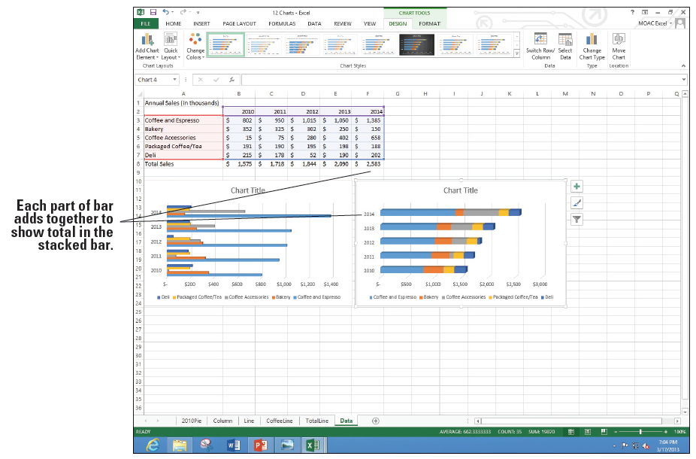
Step by Step: Create a Bar Chart
Position the stacked bar graph next to the 3-D bar graph. Your worksheet should look like the figure at right.
Click the Move Chart button, and in the New sheet box, type StackedBar and click OK.
Click the Data work- sheet tab, click the clustered bar chart, click the Move Chart button, and in the New sheet box, type ClusteredBar, then click OK.
SAVE the workbook. PAUSE. LEAVE the workbook open.

Slide 22
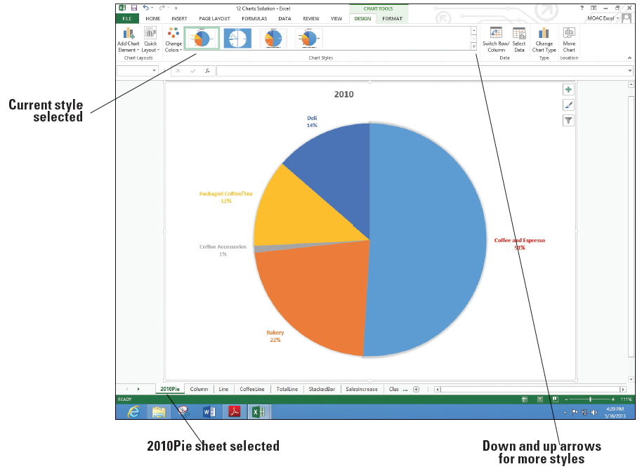
Step by Step: Format a Chart with a Quick Style
GET READY. USE the workbook from the previous exercise.
Click on the 2010Pie chart tab. If the DESIGN tab is not visible and the buttons active, click the white space inside the chart boundary and click the DESIGN tab.
One of the Chart Styles is already selected. Click each of the styles until you come to the style shown above with the labels and percentages shown next to each pie slice.

Slide 23
Step by Step: Format a Chart with a Quick Style
Click the Change Colors button and move the mouse pointer over each of the different rows to see the preview of the pie change.
Click Color 3 to make the change.
SAVE the workbook.
PAUSE. LEAVE the workbook open for the next exercise.
Notes:
Take Note: You can use the Chart Styles buttons as you are first creating an embedded chart on a worksheet or use them while editing a chart whether it is embedded or a separate chart sheet as shown here.

Slide 24
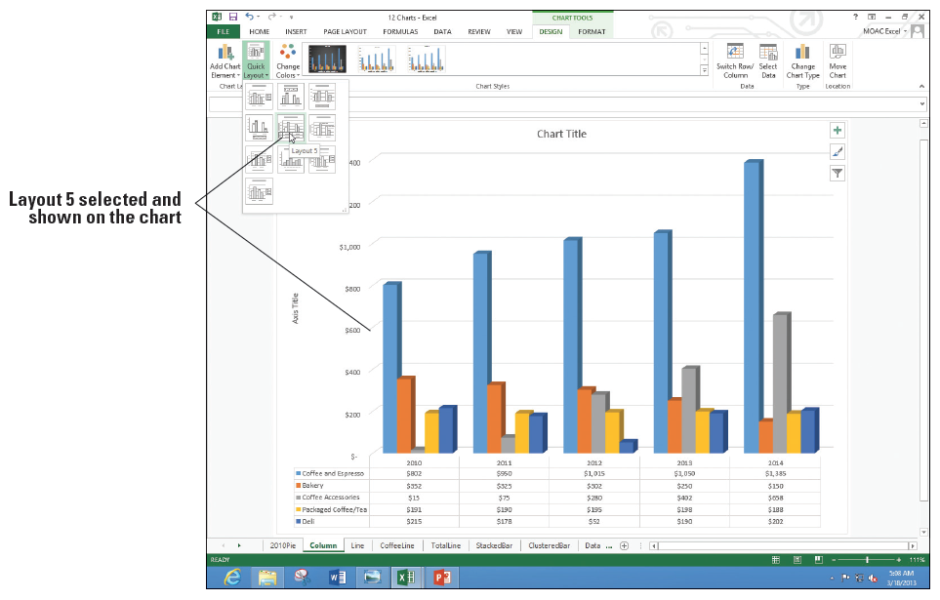
Step by Step: Format a Chart with Quick Layout
GET READY. USE the workbook from the previous exercise.
Click on the Column chart tab.
On the DESIGN tab, click the Quick Layout button. As you move to each of the options, the chart changes to preview what the option will look like (above).

Slide 25
Step by Step: Format a Chart with Quick Layout
Click Layout 5. The data table appears under the chart. The years (2010-2014) appear in both the data table and as x-axis labels.
SAVE the workbook.
PAUSE. LEAVE the workbook open for the next exercise.

Slide 26
Step by Step: Edit and Add Text on Charts
GET READY. USE the workbook from the previous exercise.
Click the 2010Pie chart tab.
Click the 2010 title, move the insertion point to the end of the label and click. Type a space and then type Annual Sales. The text appears in all caps based on the current layout.

Slide 27
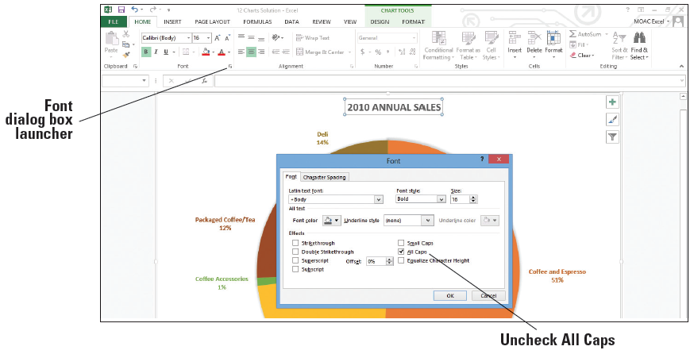
Step by Step: Edit and Add Text on Charts
Select the label text. Click the HOME tab and click the Font dialog box launcher. The Font dialog box appears (below).
Click the All Caps check box to uncheck this option. Click OK.
Add today’s date in the text box.

Slide 28
Step by Step: Edit and Add Text on Charts
Click on the FORMAT tab and click the Text Box button. Click the bottom left corner of the chart area and type your initials anEdit the chart titles on each of the charts as follows:
Chart Title Text
Column Chart Title Annual Sales
Column Axis Title Thousands
Line Chart Title Annual Sales (Thousands)
StackedBar Chart Title Annual Sales
ClusteredBar Chart Title Annual Sales
SAVE the workbook.
PAUSE. LEAVE the workbook open for the next exercise.

Slide 29
Step by Step: Format a Data Series
GET READY. USE the workbook from the previous exercise.
Click the 2010Pie chart tab.
Click in the largest slice of the pie. You can see data selectors around each of the pie slices.
Click the FORMAT tab, click the Shape Fill button, and then choose Red in the Standard Colors section. All the slices of the pie change to red. Click Undo. You want to select the largest pie slice instead of all of the pie slices.

Slide 30
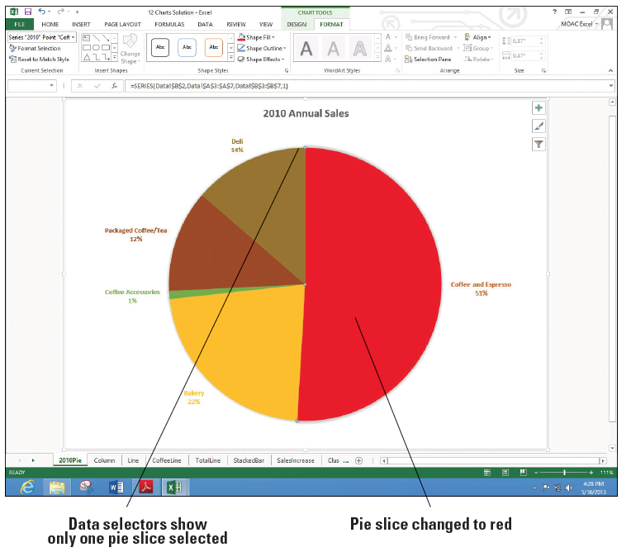
Step by Step: Format a Data Series
Click the largest pie slice again and you should see data selectors only on the slice. Click the Shape Fill button and choose Red. The Coffee and Espresso pie slice changes to Red, as shown at right.
Click the Column chart tab.
Notes:
Take Note: The first click on a data series selects the whole series. The second click selects the individual marker for the series.

Slide 31
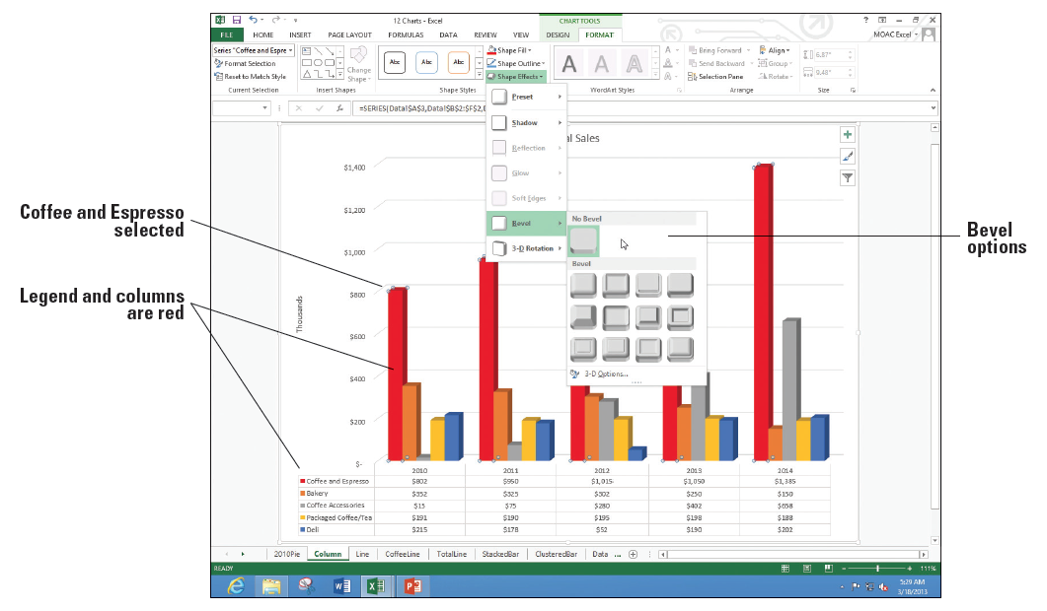
Step by Step: Format a Data Series
Click the tallest bar (Coffee and Espresso). Notice that the five bars have data selectors. Click the Shape Fill button and select Red. All five bars and the legend color for Coffee and Espresso changes to red.
Click the Shape Effects button, click Bevel and notice the options available (right).

Slide 32
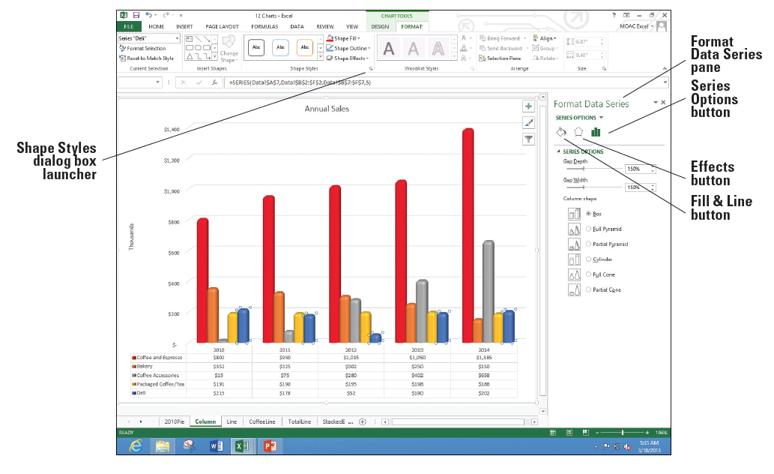
Step by Step: Format a Data Series
Click the first Bevel option (Circle). Repeat this option for each of the data series. The chart now looks like the figure below.

Slide 33
Step by Step: Format a Data Series
Besides the Shape Fill, Shape Outline, and Shape Effects buttons, you can change elements with the Shape Styles dialog box launcher. On the FORMAT tab, in the Shape Styles group, click the Shape Styles Dialog Box Launcher. The Format Data Series pane opens with the Series Options button selected.
Click each of the three buttons under the Series Options label and look at the choices. Click one of the Coffee Accessories columns.
Click the Fill and Line button, choose FILL, and select Picture or texture fill from the options.
Click the Texture drop-down arrow and choose the Brown Marble option.
SAVE the workbook.
PAUSE. LEAVE the workbook open for the next exercise.

Slide 34
Step by Step: Change the Chart’s Border Line
GET READY. USE the workbook from the previous exercise.
Click the Line chart tab and choose the FORMAT tab.
In the Current Selection group, click the arrow in the Chart Elements selection box and click Chart Area. The chart area section on the chart becomes active.
Click the More arrow in the Shape Styles group. The Shape Styles gallery opens.

Slide 35
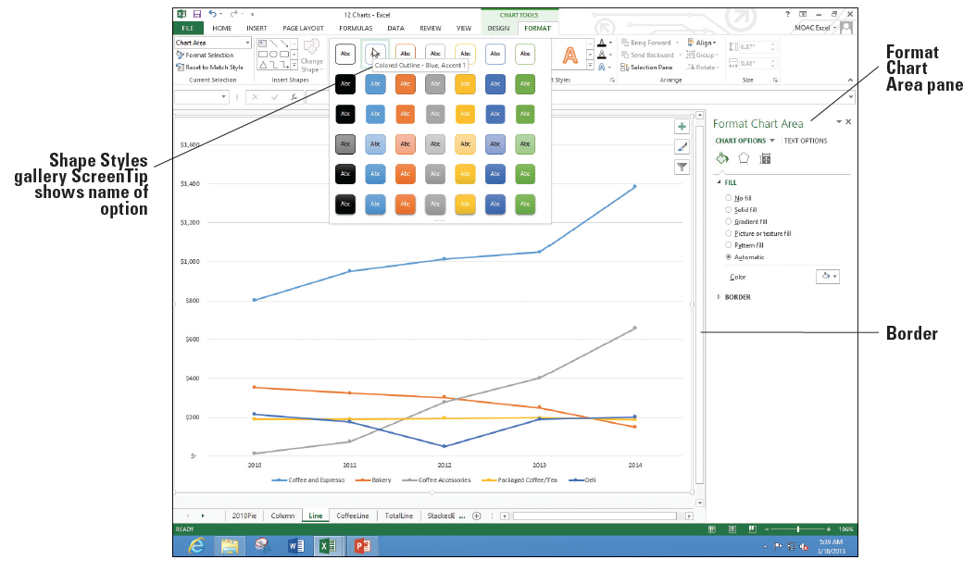
Step by Step: Change the Chart’s Border Line
Scroll through the outline styles to locate Colored Outline – Blue, Accent 1, as shown below.
Click Colored Outline – Blue, Accent 1. You might not notice a change. This is because the Width of the line may be set so thin you can't see it.

Slide 36
Step by Step: Change the Chart’s Border Line
In the Format Chart Area pane, click the BORDER arrow to expand that section.
In the Width up arrow, click until you get to 2.5 pt. Now you can see that the chart is outlined with a light blue border.
Click the Coffee and Espresso line.
In the Color drop-down, under the LINE section, choose Red.
SAVE your workbook.
PAUSE. LEAVE the workbook open for the next exercise.

Slide 37
Step by Step: Modify a Chart’s Legend
GET READY. USE the workbook from the previous exercise.
Click the Line chart tab.
On the FORMAT tab, click Chart Elements drop-down arrow, and choose Legend.
If the Format Legend pane does not appear, click the Shape Styles dialog box launcher.
Click the Legend Options button.
In the Legend Position section, click Right to move the legend to the right side of the chart.
Click the Coffee and Espresso label in the legend.
Click the TEXT OPTIONS button to display the menus for the text.

Slide 38
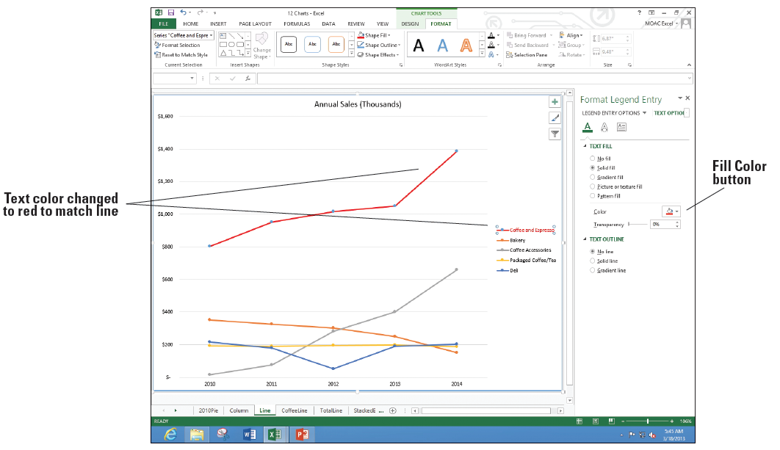
Step by Step: Modify a Chart’s Legend
In the Fill Color drop-down, choose Red so the text in the legend matches the color (below).
Click the 2010Pie chart tab.

Slide 39
Step by Step: Modify a Chart’s Legend
Click the Coffee and Espresso label twice. If necessary, click the TEXT OPTIONS button and underneath TEXT FILL, click the Color button, and choose Red to change the text color.
CLOSE the Format Data Label pane and SAVE the workbook.
PAUSE. LEAVE the workbook open for the next exercise.

Slide 40
Step by Step: Add Elements to a Chart
GET READY. USE the workbook from the previous exercise.
Click the StackedBar chart tab.
If necessary, click in a white space of the chart to select the chart and make the buttons in the upper right hand corner appear.

Slide 41
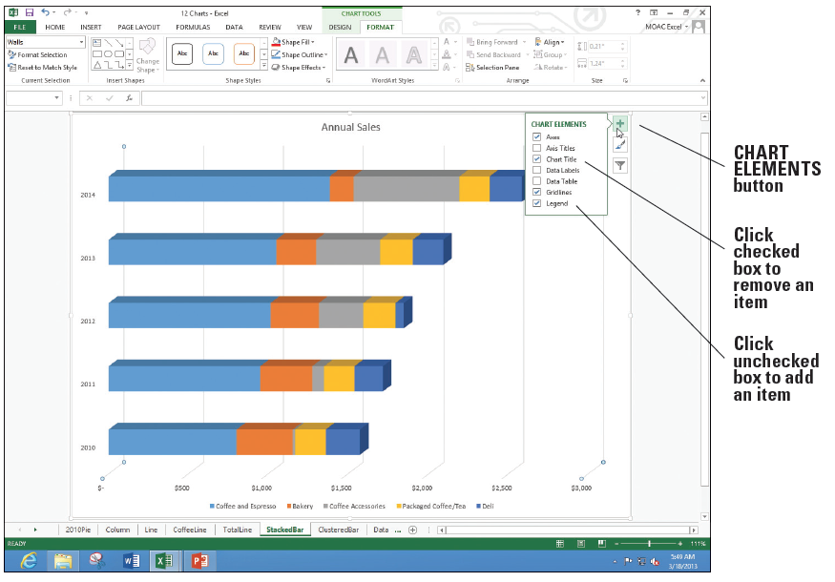
Step by Step: Add Elements to a Chart
Click the CHART ELEMENTS button. A menu appears showing which elements are currently on the chart (checked boxes) and which are not (unchecked boxes). See the figure below.

Slide 42
Step by Step: Add Elements to a Chart
Click the Axis Titles box to check the box and add both a vertical and horizontal axis placeholder.
The Axis Title on the bottom of the screen has selection indicators to indicate it is selected. Type Thousands and press Enter.
Click the TotalLine chart tab, click the CHART ELEMENTS, and select the Axis Titles option. This time the vertical Axis Title is selected. You can click any label placeholder to select it if it is already on a chart. Type Thousands for the vertical title.
Repeat the previous step to add a vertical axis title of Thousands for the CoffeeLine chart and the horizontal axis title for the ClusteredBar chart.

Slide 43
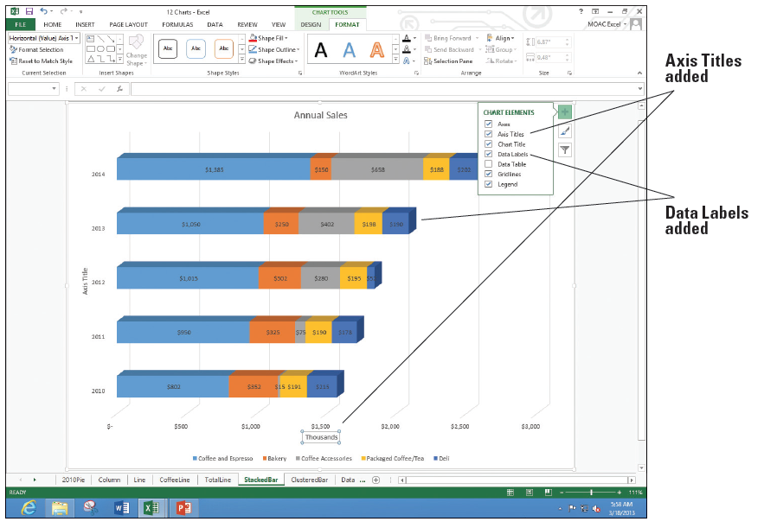
Step by Step: Add Elements to a Chart
Click the StackedBar chart tab, click the CHART ELEMENTS, and select the Data Labels option. Labels appear for each of the bars on the chart as shown below.
SAVE the workbook.
PAUSE. LEAVE the workbook open for the next exercise.
Notes:
Another Way: You can also click a text box, select the text and type the new text.

Slide 44
Step by Step: Delete Elements from a Chart
GET READY. USE the workbook from the previous exercise.
On the StackedBar chart sheet tab, click the vertical Axis Title and press Delete.
Repeat Step 1 to delete the following generic Axis Title labels:
Chart tab Vertical or Horizontal Axis Title
CoffeeLine Horizontal
TotalLine Horizontal
ClusteredBar Vertical

Slide 45
Step by Step: Delete Elements from a Chart
Right-click the StackedBar chart tab and select Move or Copy. In the Before sheet list box, Select ClusteredBar, click the Create a copy check box, and then click OK to create another copy of the StackedBar chart.
Double-click the StackedBar (2) label for the tab and type SalesIncrease for the new name.
Click the $150 data label for the Bakery in 2014. All data labels for bakery have selection indicators. Press Delete.
Repeat Step 5 for Coffee Accessories, Packaged Coffee/Tea, and Deli data labels.
Click the Annual Sales title and type Coffee, Espresso, and Accessories only Consistent Sales Increase. Press Enter.

Slide 46
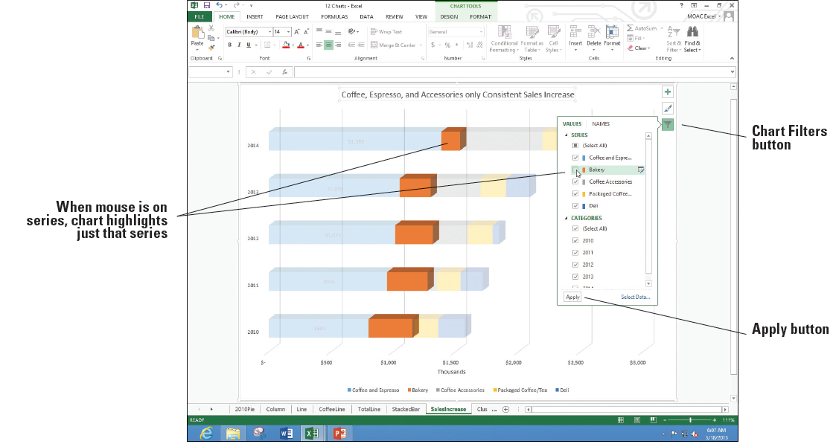
Step by Step: Delete Elements from a Chart
You can also hide data series. Click the Chart Filters button on the right side of the chart and in the SERIES group, click Bakery to uncheck it (below).

Slide 47
Step by Step: Delete Elements from a Chart
Repeat step 8 for Packaged Coffee/Tea and Deli and click the Apply button.
After looking at the chart, you might decide it is better to keep all of the data series. Repeat Steps 8 and 9 to recheck the Bakery, Packaged Coffee, and Deli.
SAVE the workbook.
PAUSE. LEAVE the workbook open for the next exercise.
Notes:
Take Note: Compare this to previous versions of Excel when you removed series from a chart. The Chart Filters button is much easier to put the series back on.
Another Way: You can also delete a chart element by right-clicking on the element and selecting Delete.
Take Note: It is important to remember that whether the chart is embedded in the worksheet or located on a chart sheet, the chart is linked to the worksheet data. Any changes in the worksheet data are reflected in the chart. Likewise, if the worksheet data is deleted, the chart is also deleted.

Slide 48
Step by Step: Add Additional Data Series
GET READY. USE the workbook from the previous exercise.
Right-click the Data worksheet tab, select Move or Copy, scroll to the bottom of the Before sheet list, and select (move to end). Click the Create a copy checkbox and click OK. Double-click the Data (2) tab, type DataExp, and then press Enter.
Select A2:F7, click the INSERT tab, click the Insert Column Chart button, and then under 2-D Column, click the Clustered Column option.

Slide 49
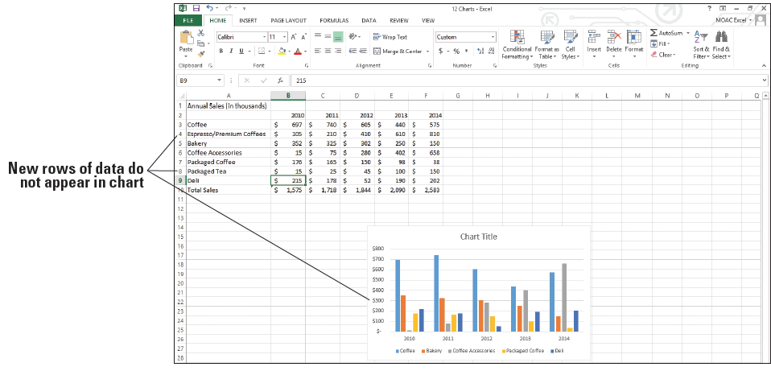
Step by Step: Add Additional Data Series
Insert rows below Coffee and Espresso and Packaged Coffee/Tea. Edit the labels and values as shown below.

Slide 50
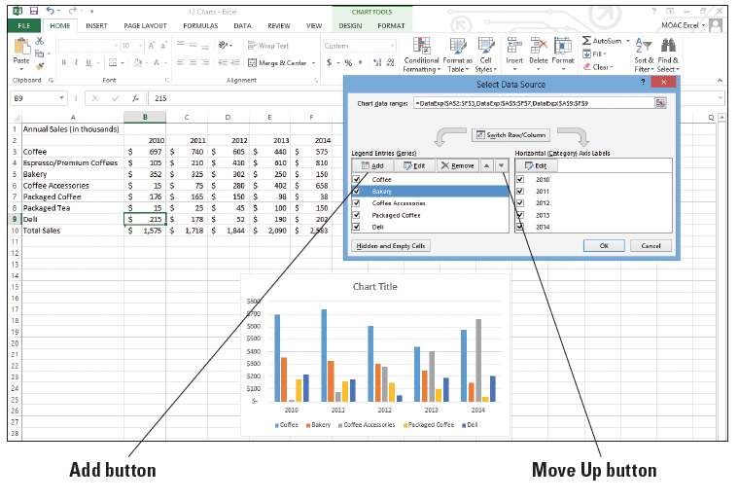
Step by Step: Add Additional Data Series
Right-click in a blank area of the chart, and choose Select Data. The Select Data Source dialog box opens (below).
Notes:
Another Way: You can also click the DESIGN tab and the Select Data button.
Take Note: In the previous section, you used the Chart Filter button to remove data series. You can also use this Select Data Source dialog box to remove data series.

Slide 51
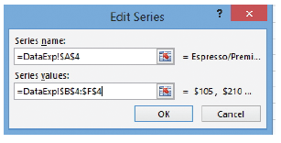
Step by Step: Add Additional Data Series
Click the Add button and in the Series name box, click cell A4. In the Series values box, delete the entry and drag on the worksheet to select cells B4:F4. The Edit Series dialog box looks like the figure below.
Click OK, then click the Move Up button multiple times to move the Espresso/Premium Coffees label below Coffee.

Slide 52
Step by Step: Add Additional Data Series
Repeat Steps 4 and 5 with Packaged Tea in A8 and the data in B8:F8 so the label is below Packaged Coffee. Click OK to accept the changes and return to the sheet.
SAVE the workbook.
PAUSE. LEAVE the workbook open for the next exercise.
Notes:
Another Way: You can also highlight the data in the worksheet, click Copy, click on the chart, and click Paste to add a data series to a chart.

Slide 53
Step by Step: Resize a Chart
GET READY. USE the workbook from the previous exercise. The DataExp sheet should be selected.
Move the mouse to the white space to the left of the chart title. The mouse is a black four-headed arrow. Drag to move the chart to the left edge of the sheet and below row 11.
Move the mouse to the bottom right corner of the chart. The mouse pointer is a two-headed diagonal arrow on the resize handle. Drag the mouse so it is in the bottom right corner of the screen. The chart expands to take up more of the screen and you can see the columns and legend easier.

Slide 54
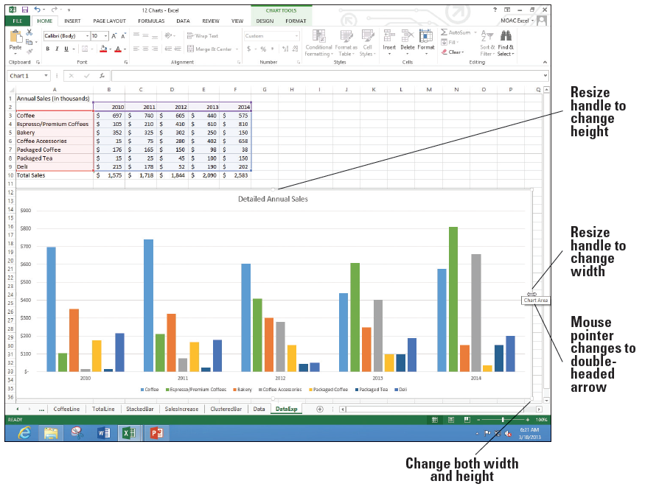
Step by Step: Resize a Chart
Click the Chart Title and type Detailed Annual Sales. Click back in the chart to select the chart and move to the right center resize handle. Your screen should look similar to the figure at right.
SAVE the workbook.
PAUSE. LEAVE the work- book open for the next exercise.
Notes:
Take Note: You can click the selection handle on the chart border and drag to increase the height, width, or both.

Slide 55
Step by Step: Choose a Different Chart Type
GET READY. USE the workbook from the previous exercise. The DataExp sheet should be visible and the chart selected.
Click the DESIGN tab and select the Change Chart Type button. The Change Chart Type dialog box opens.

Slide 56
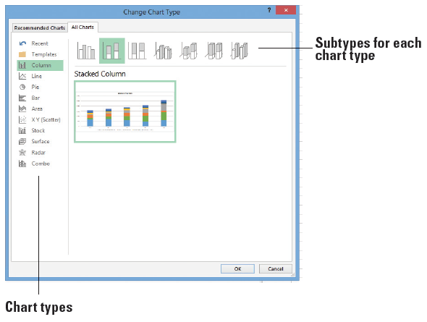
Step by Step: Choose a Different Chart Type
Click each of the chart types on the left and you will see a set of different icons representing sub- types for each of the chart types. Click the Column button. Click the Stacked Column subtype (second icon in the right pane, at the top of the dialog box). The screen should look like thefigure at right.

Slide 57
Step by Step: Choose a Different Chart Type
Click OK.
Click the Move Chart button and in the New sheet box, type DetSales, and then click OK.
COPY the DetSales chart sheet before the DataExp sheet and NAME the tab DetSalesEs.
On the DESIGN tab, using the Change Chart Type button, change the chart back to a Clustered Column.
Click just one of the Espresso/Premium Coffees columns.
On the DESIGN tab, click the Change Chart Type button.

Slide 58
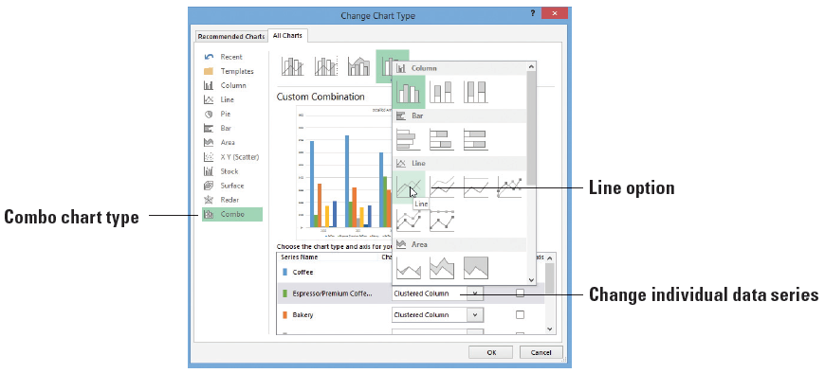
Step by Step: Choose a Different Chart Type
The Change Chart Type box opens to the Combo chart type. In the Espresso/Premium Coffees Chart Type box, select Line (below).
Click OK and edit the chart title to read WOW! Look at Espresso/Premium Coffee Sales!

Slide 59
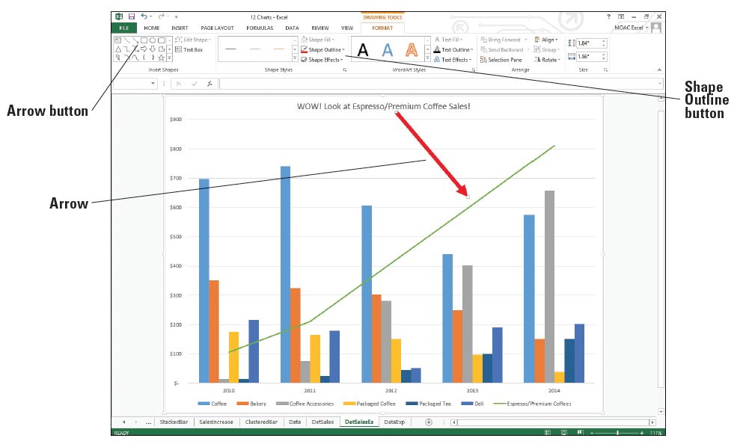
Step by Step: Choose a Different Chart Type
Click the FORMAT tab and in the Insert Shapes group, click the Arrow button and drag the arrow from the chart title to the Espresso line. Use the Shape Outline button to change the arrow to Red and the Weight to 6 pt. Your chart should look similar to the figure below.
SAVE the work- book.
PAUSE. LEAVE the workbook open for the next exercise.

Slide 60
Step by Step: Switch Between Rows and Columns in Source Data
GET READY. USE the workbook from the previous exercise.
COPY the DetSales chart sheet before the DataExp sheet and NAME the tab DetSalesCat.
On the DESIGN tab, use the Change Chart Type button to change the chart back to a Clustered Column.

Slide 61
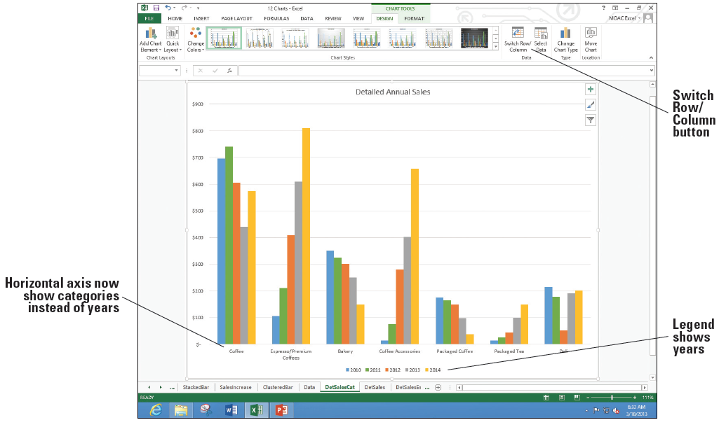
Step by Step: Switch Between Rows and Columns in Source Data
The horizontal axis shows each year and the categories repeat within each year. We're going to change the chart so each category is a group and each year is shown as a different bar color. On the DESIGN tab, click the Switch Row/Column button. The chart changes (below).
SAVE the work- book.
PAUSE. LEAVE the workbook open for the next exercise.

Slide 62
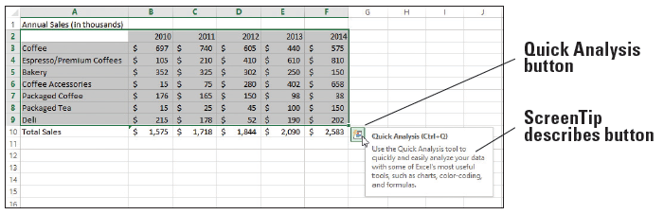
Step by Step: Add a Chart or Sparklines
GET READY. USE the workbook from the previous exercise.
Click the DataExp worksheet tab. Select cells A2:F9. The new Quick Analysis icon appears at the bottom right of the selected range. Move the mouse pointer to the button and the ScreenTip displays (below).

Slide 63
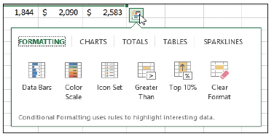
Step by Step: Add a Chart or Sparklines
Click the Quick Analysis button. A small window called the Quick Analysis gallery opens (below).
Notes:
Another Way: You can also press Ctrl + Q to open the Quick Analysis Gallery.

Slide 64
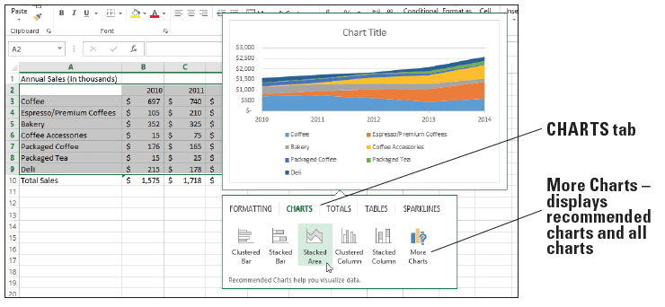
Step by Step: Add a Chart or Sparklines
Click the CHARTS tab in the gallery. Move the mouse pointer to each of the charts and a preview appears on the screen above the Quick Analysis gallery. For example, move the mouse pointer to the Stacked Area option and you'll see a preview showing this type of chart (below).
Notes:
Take Note: If you click the More Charts option, Excel displays the Insert Chart dialog box, with the Recommended Charts and All Charts tabs discussed earlier in this lesson.

Slide 65
Step by Step: Add a Chart or Sparklines
We will not add any charts from the CHARTS menu at this time.
Click the SPARKLINES tab. Move the mouse pointer to preview the Column option. A set of tiny column charts shows in column G.
Click the Line option. A series of lines appear in your worksheet in column G.
Row 2 (years) should not have a sparkline. Click cell G2 and on the DESIGN tab, click the Clear button. The sparkline is removed in that cell. In cell G2, type Sparkline.
Click cell G9. Use the fill handle to drag to cell G10. A sparkline appears for the total.

Slide 66
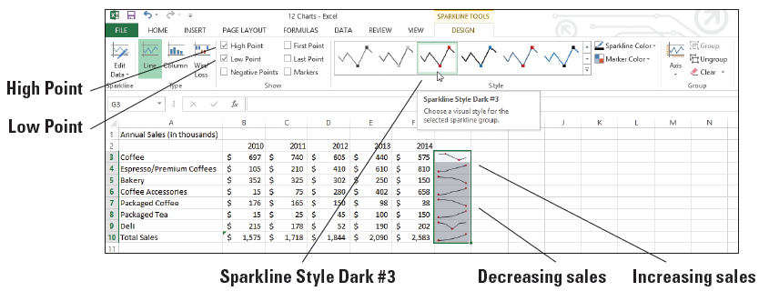
Step by Step: Add a Chart or Sparklines
Select G3:G10 and click the DESIGN tab. There are a number of options you can do with the sparklines.
In the Show group, click High Point and Low Point and in the Style gallery, choose Sparkline Style Dark #3 (below).
SAVE the workbook.
PAUSE. LEAVE the workbook open for the next exercise.
Notes:
Take Note: The DESIGN tab changes to SPARKLINE TOOLS when you have sparklines selected. Take the time to explore the options on the Ribbon shown above.

Slide 67
Step by Step: Work with Totals
GET READY. USE the workbook from the previous exercise and click on the Data worksheet tab.
Select A3:F7. Click the Quick Analysis button and select the TOTALS tab.
Move to the first icon, Sum (with the blue row highlighted in the icon). You’ll see a preview on the worksheet of Sum overwriting the Total Sales row that was already there.
Move to the next icon and you’ll see row 8 previewed with Averages for each column. Move to each of the Count, % Total, and Running total icons and watch the preview of the worksheet change.
Move to the second Sum icon (with the orange column highlighted). Notice that the worksheet preview changes to show totals in column G.

Slide 68
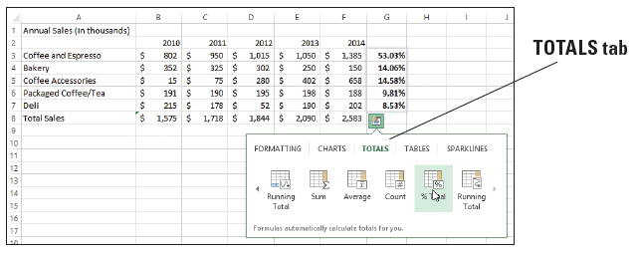
Step by Step: Work with Totals
Click the arrow on the right to show more options. Preview each of the options and return to % Total (below).
Click the % Total option. Click cell G3 and notice the formula =SUM(B3:F3)/SUM($B$3:$F$7) appears in the formula bar.
In cell G2, type Average.
SAVE the workbook.
PAUSE. LEAVE the workbook open for the next exercise.

Slide 69
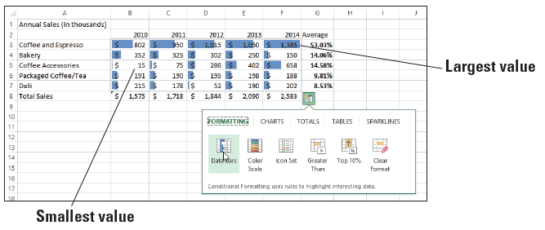
Step by Step: Apply Conditional Formatting
GET READY. USE the workbook from the previous exercise. You should still be on the Data worksheet tab.
Select A3:F7. Click the Quick Analysis icon. The FORMATTING tab is selected.
Move to the first icon, Data Bars. You can see a preview on the work- sheet of small bars in each cell indicating the relative value in the cell. The largest value is in F3 and the bar shows the largest width (above).

Slide 70
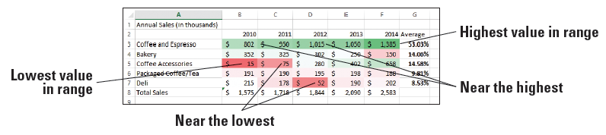
Step by Step: Apply Conditional Formatting
Click the Color Scale option to make this choice. Click in a cell outside the range so the formatting is clearer. The worksheet is formatted (below) with the highest values in green with the highest value in dark green. The lowest values are in red.
If the value is close to the highest or lowest value, the color or the cell is less dark. As the values move away from the value, the color becomes lighter.
SAVE and CLOSE the workbook.
PAUSE. LEAVE Excel open for the next exercise.

Slide 71
Step by Step: Create a Basic PivotTable
GET READY. OPEN 12 School Test Data from the student data files.
Click cell A1. Press End and then press the down arrow. Notice that there are 139,129 rows of data.
Press Ctrl + Home to return to the top of the worksheet.
On the INSERT tab, click the Recommended PivotTables button.

Slide 72
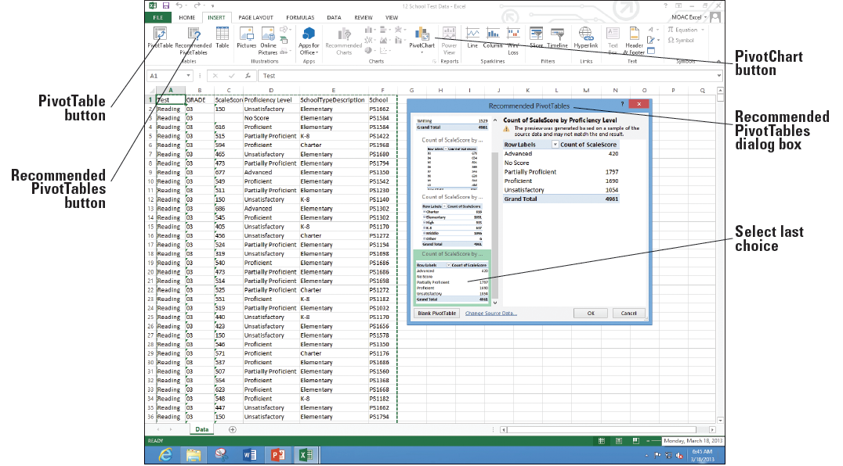
Step by Step: Create a Basic PivotTable
Scroll to the bottom and click Count of ScaleScore by Proficiency Level (below).

Slide 73
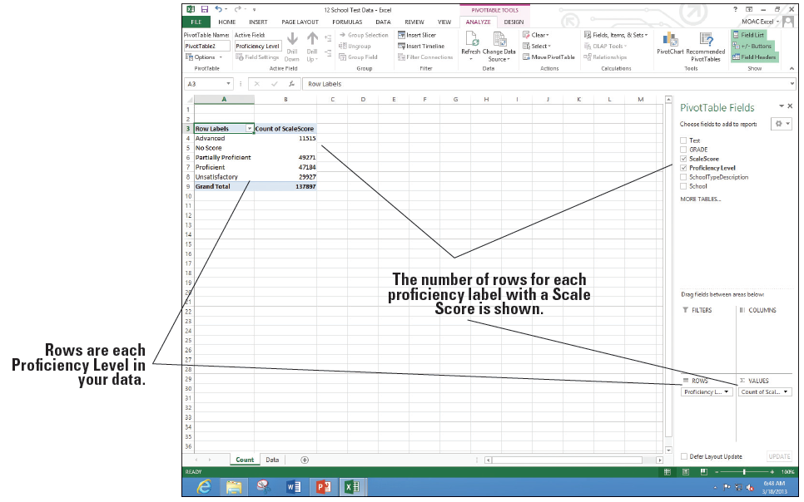
Step by Step: Create a Basic PivotTable
Click OK and NAME the new sheet Count. The PivotTable Fields pane opens on the right side of your screen and the data appears on the worksheet (below). Notice that the data for No Score is blank. You will want to change the field to count to a field that has data. If you look back on the Data tab, every row is filled by a grade so you can use this column so every row is counted.

Slide 74
Step by Step: Create a Basic PivotTable
Return to the Counts sheet and drag the Grade field in the PivotTable Fields pane down to the VALUES section.
Drag the Count of ScaleScore from the VALUES section into the worksheet to remove it. Notice that the No Score row now counts each missing score.
Drag the Grade field to the COLUMNS area. You'll see each grade summarized.
Drag the Test field to the FILTERS area.
Cell B1 currently shows (All). Click the Filter drop-down arrow, choose Math, and click OK.

Slide 75
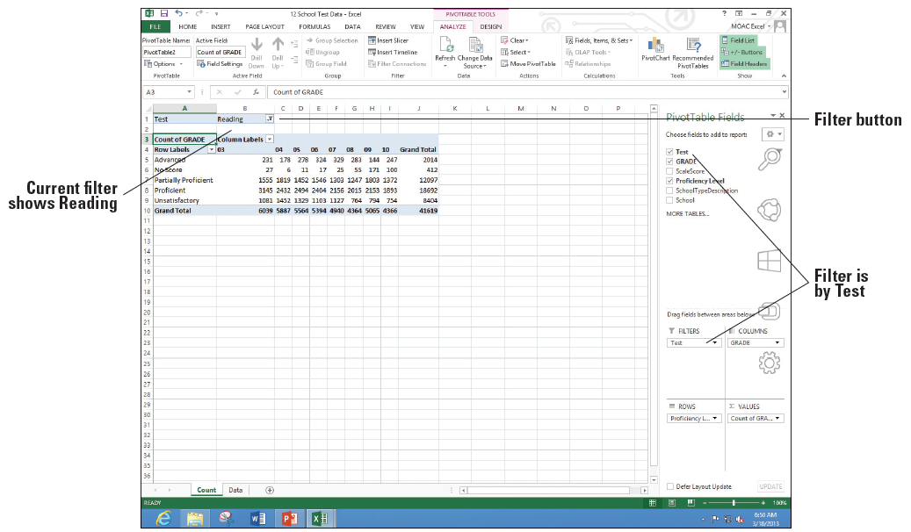
Step by Step: Create a Basic PivotTable
On the Filter button, click cell B1 and choose Reading. Click OK. Your data should look similar to the figure at right.
SAVE the workbook as 12 Test PivotTable Solutions.
PAUSE. LEAVE the workbook open for the next exercise.
Notes:
Take Note: When you click any empty cell on the PivotTable, the Field list disappears. To make it reappear, you simply need to click on any active cell that is showing data.

Slide 76
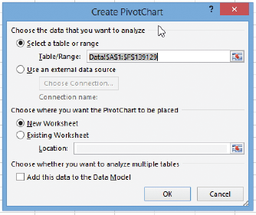
Step by Step: Add a PivotChart
GET READY. USE the workbook from the previous exercise.
On the Data worksheet, click cell A1.
On the INSERT tab, click the PivotChart button and choose PivotChart. The Create PivotChart dialog box opens and the range is selected (right).

Slide 77
Step by Step: Add a PivotChart
The default location is for a New Worksheet so click OK. NAME the new sheet tab PivotChart.
Drag the Test field to the FILTERS area.
Drag Grade to the VALUES area (count number of items).
Drag Grade again to the AXIS area.
Drag Proficiency Level to the LEGEND area.
Drag Test to the FILTERS area.
MOVE the chart to the left edge of the worksheet, below the data, and then resize the chart (see Figure 12-48).

Slide 78
Step by Step: Add a PivotChart
On the Test drop-down arrow on the chart, choose Science and click OK. Notice that only 5th, 8th, and 10th grades are available because only those grades take the Science test.
Click the FORMAT tab, click the Text Box button, and click the top of the chart. Add a label that says Student Science Test Scores and make this label Bold and 18 points.
Click cell A3 and change the label to just say Count.
In F4, click on the label for Unsatisfactory.

Slide 79
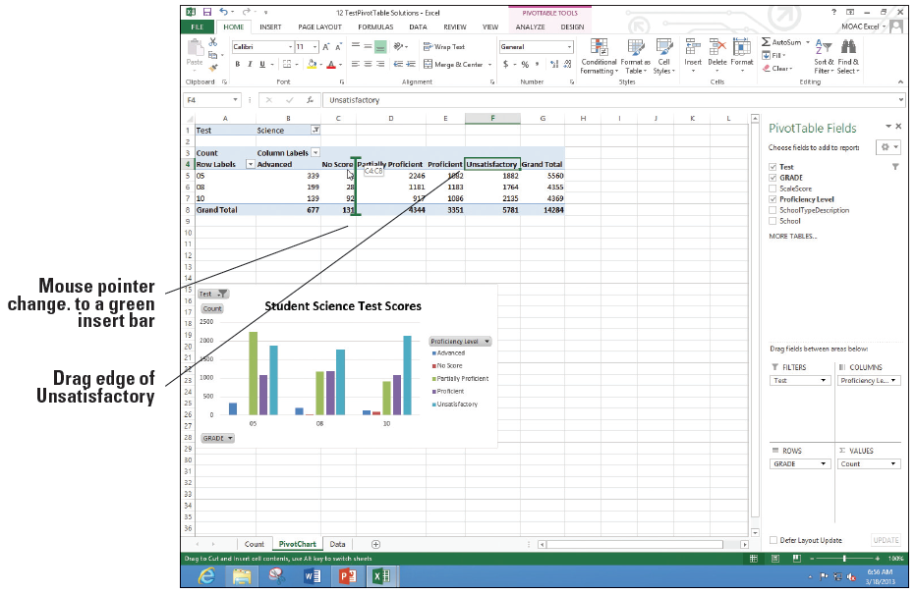
Step by Step: Add a PivotChart
Move the mouse pointer to the left edge of the cell until the mouse pointer changes to a four-headed black arrow and drag the mouse between columns C and D (below).

Slide 80
Step by Step: Add a PivotChart
Repeat Step 14 and move the Advanced column to between Proficient and Grand Total.
SAVE the work- book as 12 Test PivotChart Solution. Your final sheet should look like that shown at right.
PAUSE. CLOSE the workbook and LEAVE Excel open for the next exercise.

Slide 81
Skills summary

